Slide 1
Mushrooms: To Eat, or Not To Eat?
Victoria White​

Slide 2
Introduction
Wild mushrooms are commonly gathered to be used for things such as cooking and medicinal needs. When ingesting these mushrooms could be a matter of life or death, we want to be able to quickly classify whether those wild mushrooms are poisonous or edible.

Slide 3
Primary Goal
Predicting if a mushroom is edible or poisonous based on its characteristics

Slide 4
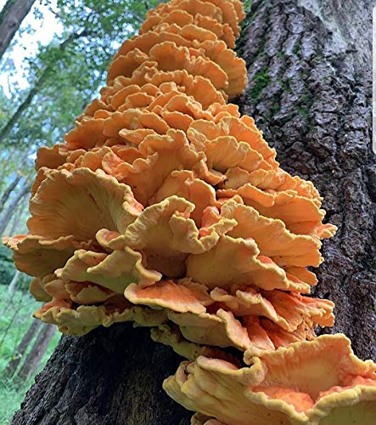
Chicken of the Woods
There is a species of mushroom that grows wild on hardwood trees called ‘chicken of the woods.' It has a meaty texture similar to chicken.

Slide 5
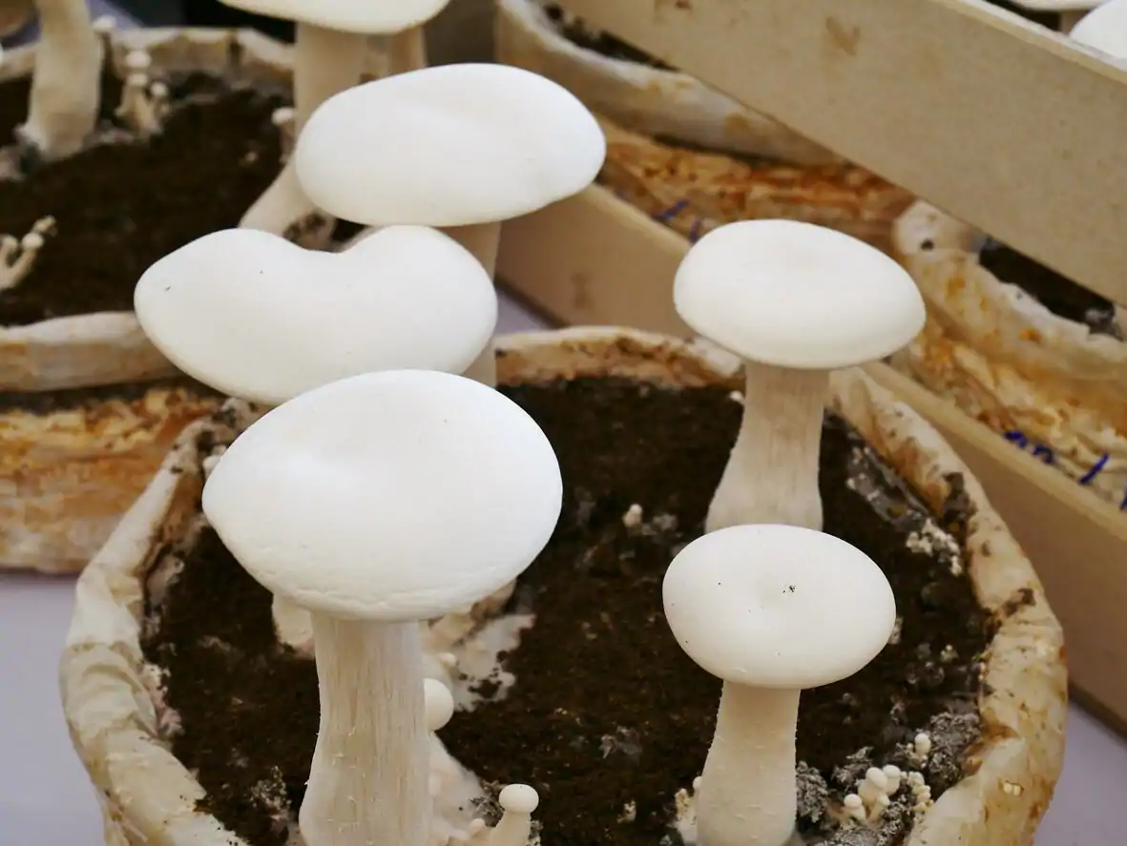
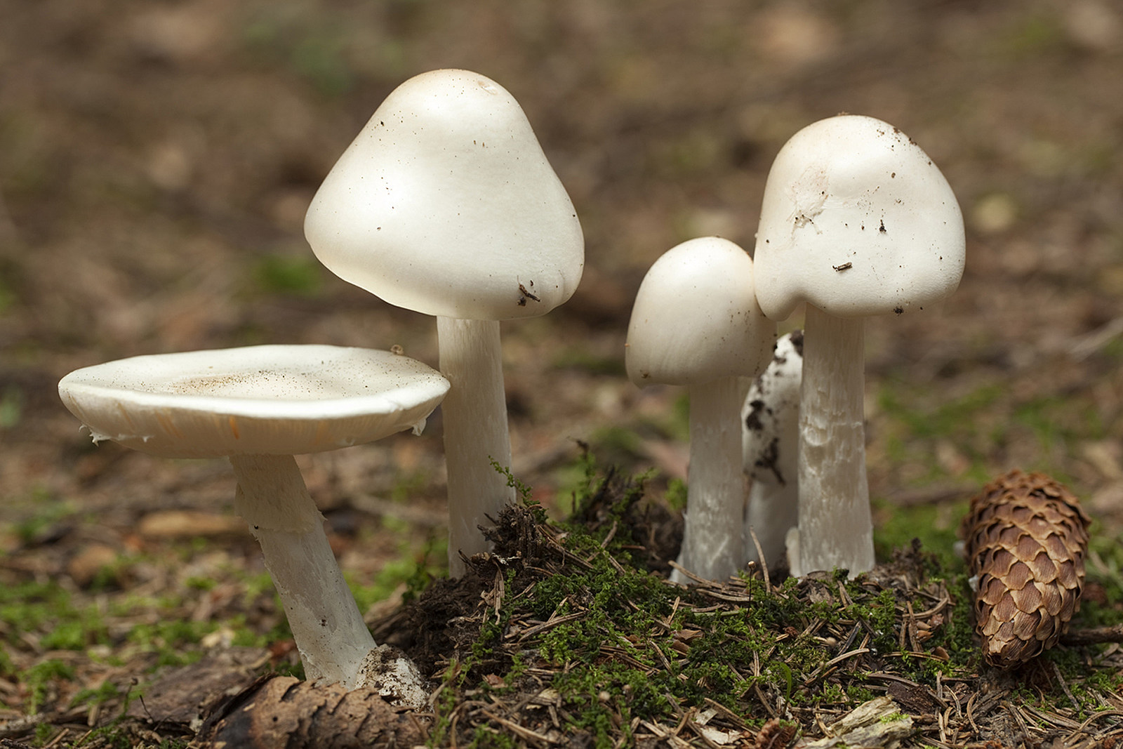
Grocery Staple or Untimely Death?
The top image is an immature ‘common mushroom’ (Agaricus bisporus), commonly found in local stores around the world.
The bottom image is an immature ‘destroying angel’ (Amanita ocreata), which causes gastrointestinal issues before causing liver and kidney failure. Death typically occurs 6-16 days after ingestion.
 | Button Mushroom | Destroying Angel
Stipe or Stalk | Ring | Ring AND Vulva
Spore Print | Brown | White

Slide 6
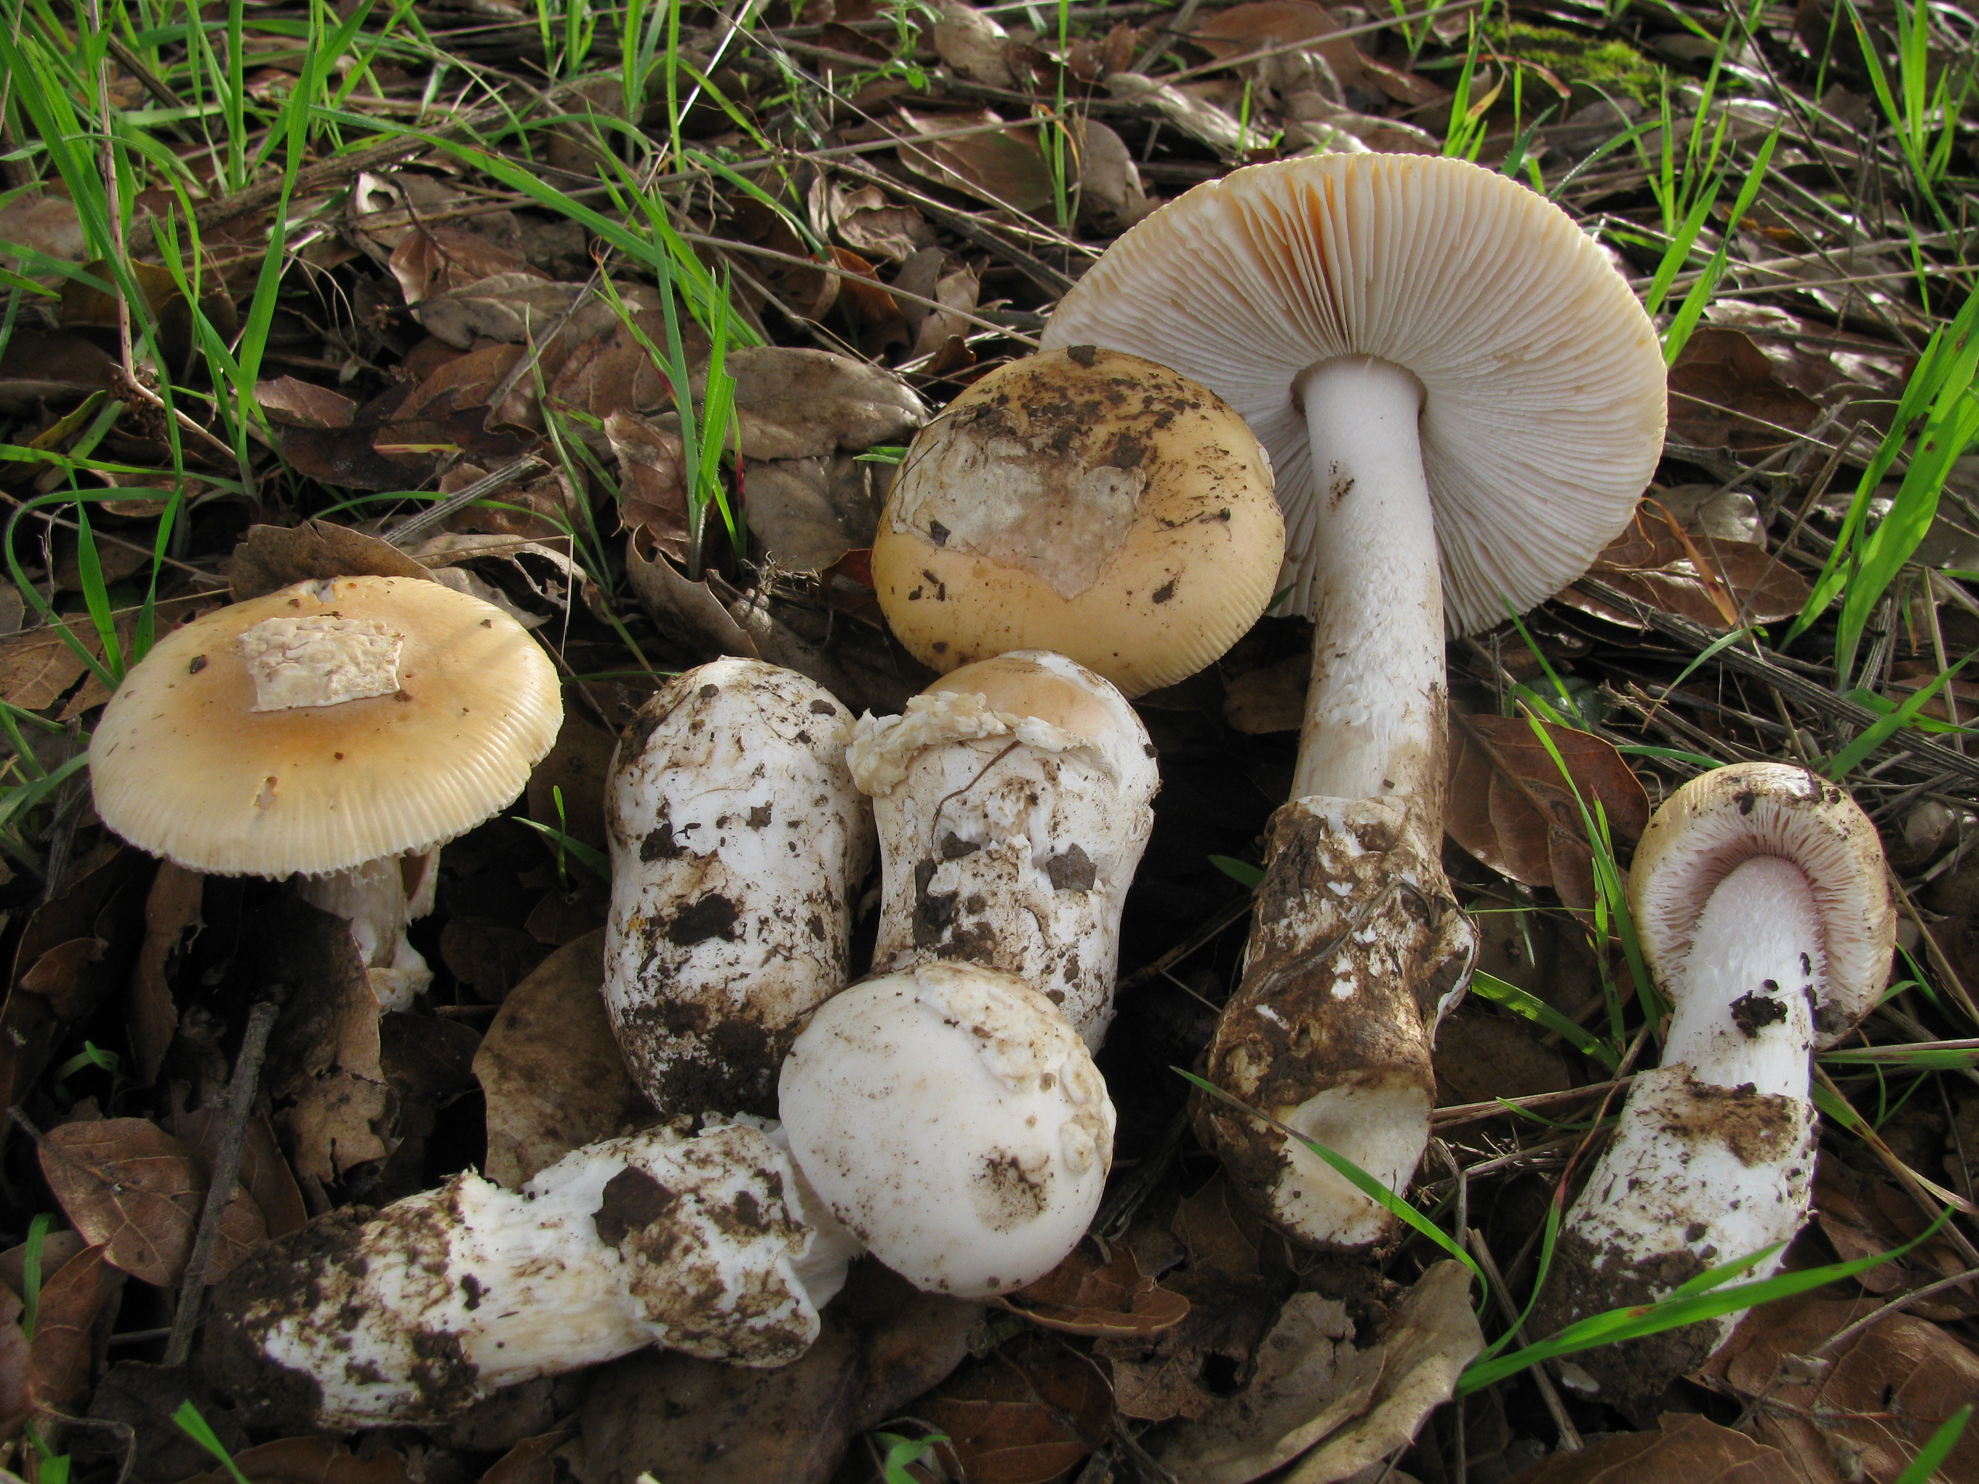
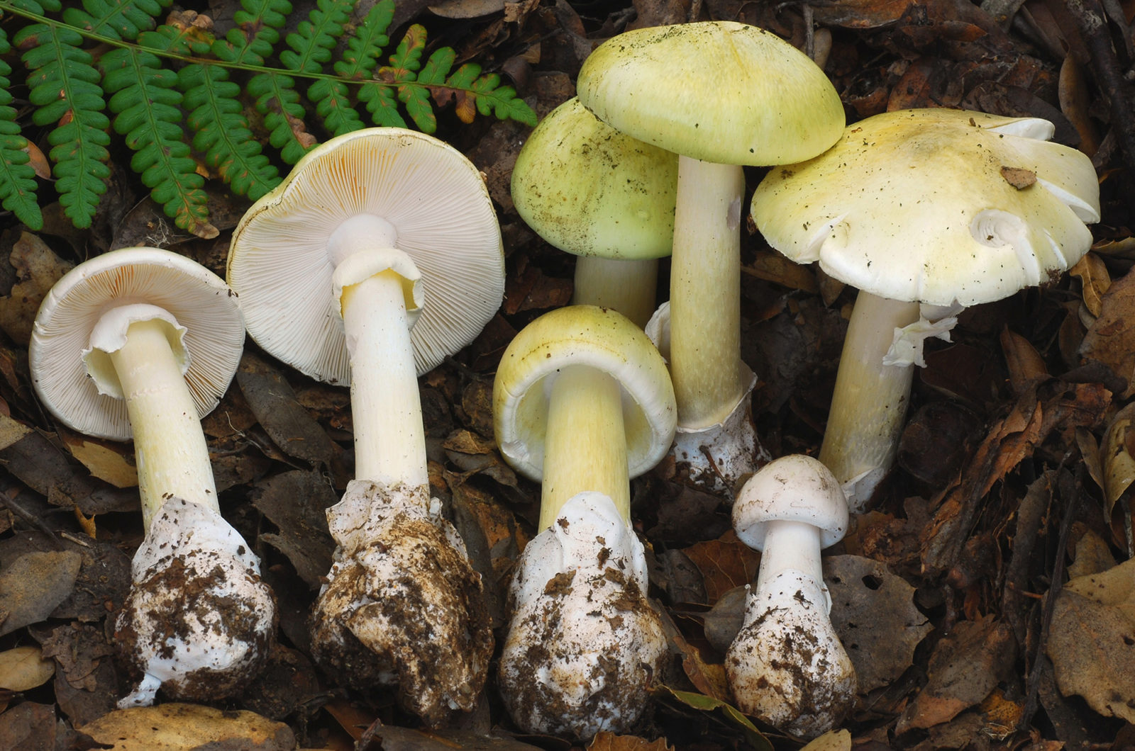
Nutritional Snack or Your Last Meal?
The top mushroom is a ‘ springtime amanita’ (amanita velosa), which is commonly consumed for its sweet or nutty flavor.
The bottom mushroom is a ‘death cap’ (amanita phalloides). Like the destroying angel, the death cap causes gastrointestinal problems and can result in liver and kidney failure. Death generally occurs six to sixteen day after poisoning.
 | Straw Mushroom | Death Cap
Cap Shape | Convex or Flat | Conical
Spore Print | White | White
Stipe or Stalk | Volva | Ring AND Volva

Slide 7
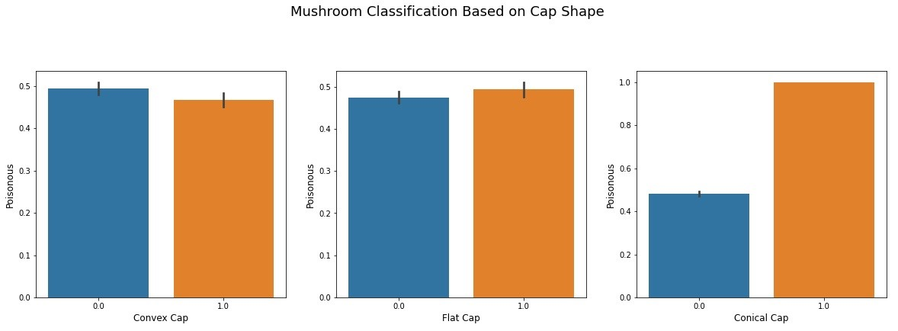
Classifying by Cap Shape

Slide 8
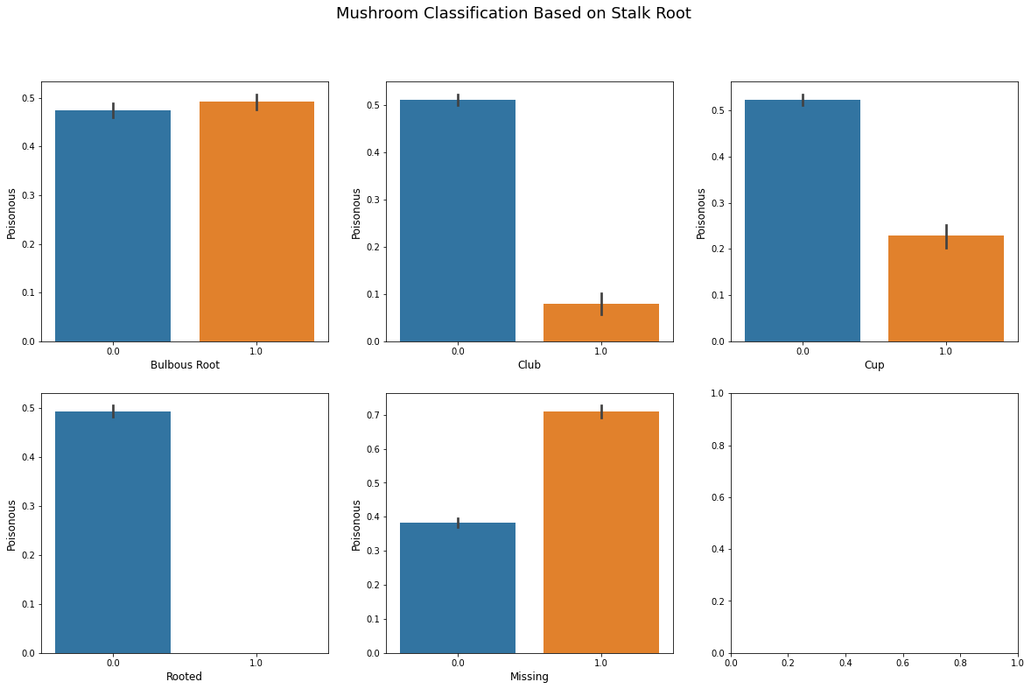

Slide 9
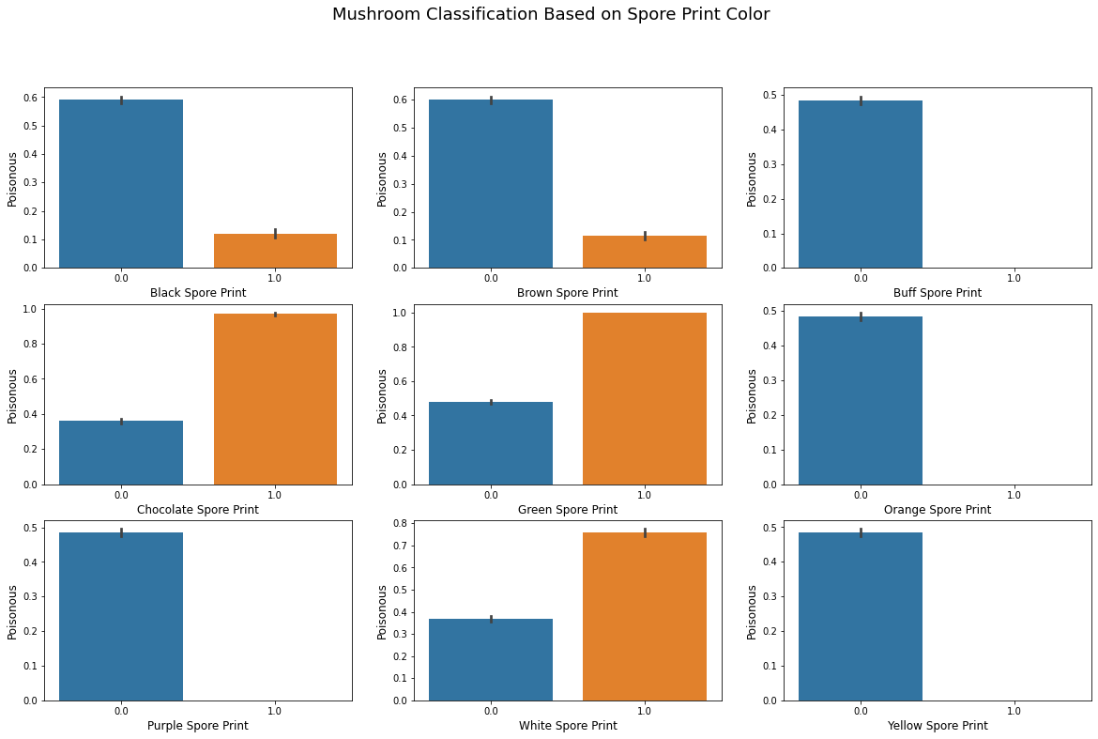

Slide 10
Classifying Mushrooms
Edible:
Red, orange
Likely Edible:
Black, brown, white, purple,
Likely Poisonous:
Gray, chocolate, buff, green
Spore Print Color
Stalk/Stipe Root
Edible:
Rooted
Likely Edible:
Club, Cup
Likely Poisonous:
Bulbous
Ring Type
Edible:
Flaring
Likely Edible:
Pendant
Likely Poisonous:
Large, Evanescent, No ring
Likely Edible:
No odor
Likely Poisonous:
Fishy, creosote, foul, musty, pungent, spicy
Gill Color
Odor
Edible:
buff, orange,
purple, yellow
Likely Poisonous:
chocolate,
white, green

Slide 11
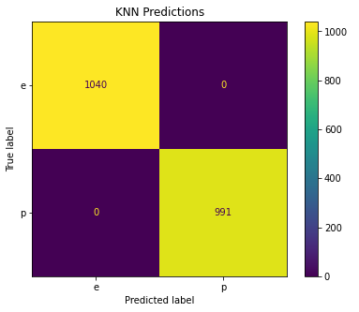
Predictions
Created a model that can correctly identify 100% of the mushrooms in our data
We would want to reduce any false negatives, stating a mushroom is edible when it is poisonous
Data is balanced, but highly correlated which results in 100% accuracy

Slide 12
Summary
There are many species of mushrooms that are safe to eat, but they have lookalikes that could be deadly. We want to be able to compare different characteristics of a mushroom to be able to confidently identify what is safe to eat. A good place for novice gatherers to start is by identifying stalk root, spore print color, gills, and odor. .

Slide 13
Thank you
Victoria White
victoria.white17@hotmail.com
https://github.com/victoriawhite17/Mushroom-Class

Slide 14
Works Cited
Dua, D. and Graff, C. (2019). UCI Machine Learning Repository [http://archive.ics.uci.edu/ml]. Irvine, CA: University of California, School of Information and Computer Science.
Mushroom, M. (2022, August 20). Mushroom Identification Pictures and examples. Mushroom Appreciation. Retrieved September 29, 2022, from https://www.mushroom-appreciation.com/mushroom-identification.html
Wikimedia Foundation. (2022, September 27). Mushroom. Wikipedia. Retrieved September 29, 2022, from https://en.wikipedia.org/wiki/Mushroom

